Slide 1
Data Analysis
[Session 4]
Group number: 3
Case title: Lullaby
Group members: Casey Filler & Soroush Dianaty

Slide 2

Primary Analysis: Identify and conduct analyses to answer case study hypothesis questions.
1. Exploratory Analysis
2. Multivariate Logistic Regression
Total Pregnancies (Gravida)
Median = 2
Mean: 1 | Max: 6
Delivery
Min: 0 | Max: 3
Validates algorithm in our specific population.
Primary Outcome Binary: Y/N CV Event
Multiple Predictors: Utilized for robustness.
Determines if combinations of physiologic and behavioral variables associate with increased odds of a PP CV event.

Slide 3

Secondary Analysis: Future studies and additional data insights.
1. Adherence & Engagement
2. Behavioral Response
Predictors of Disengagement:
Wear time & scale adherence
Survey completion & reminder response
Mental health & social support measures
Goal: Design adaptive strategies and smarter reminder systems.
Multimodal Alert Monitoring:
Analyzing reactions to repeated alerts over time.
Alert frequency & hotline calls
App interaction logs & response time
Combine multiple data streams for comprehensive understanding.

Slide 4
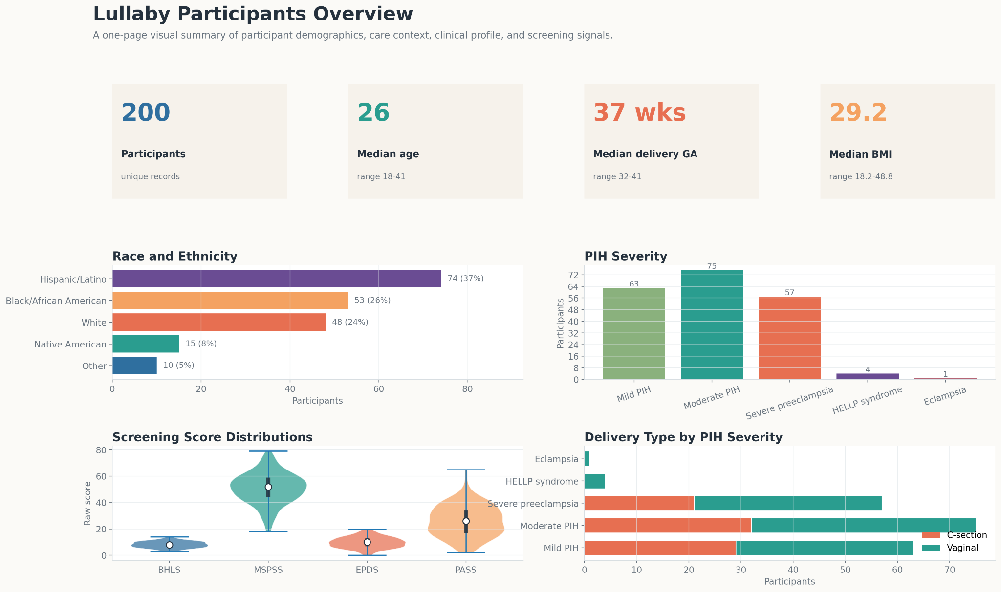

Slide 5
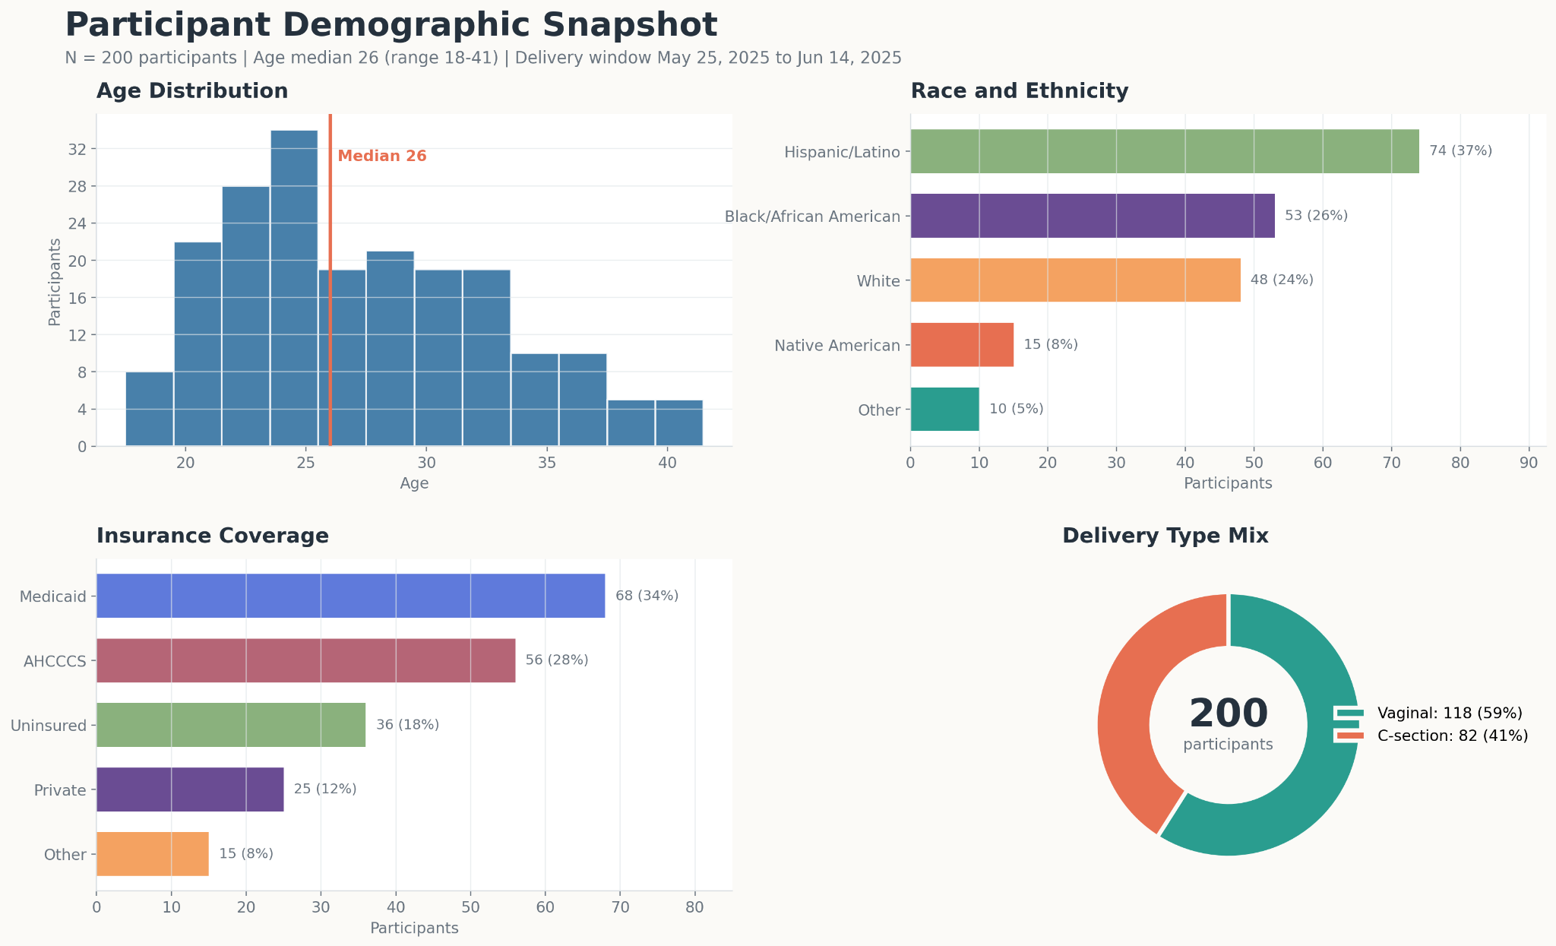

Slide 6
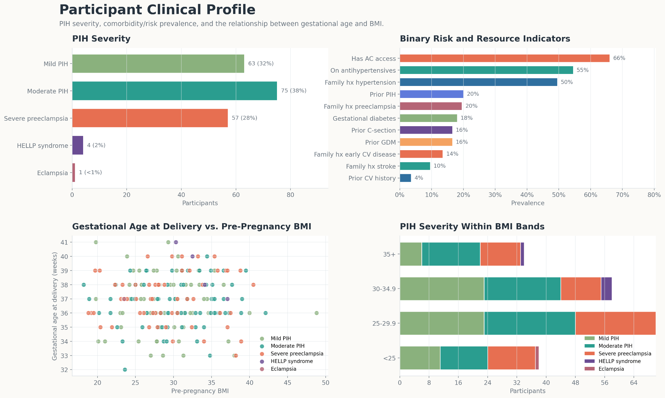

Slide 7
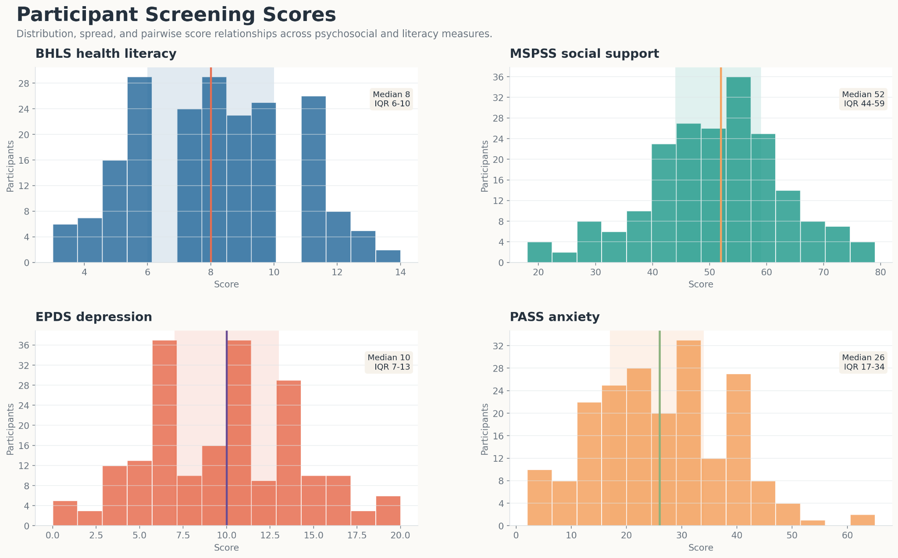

Slide 8
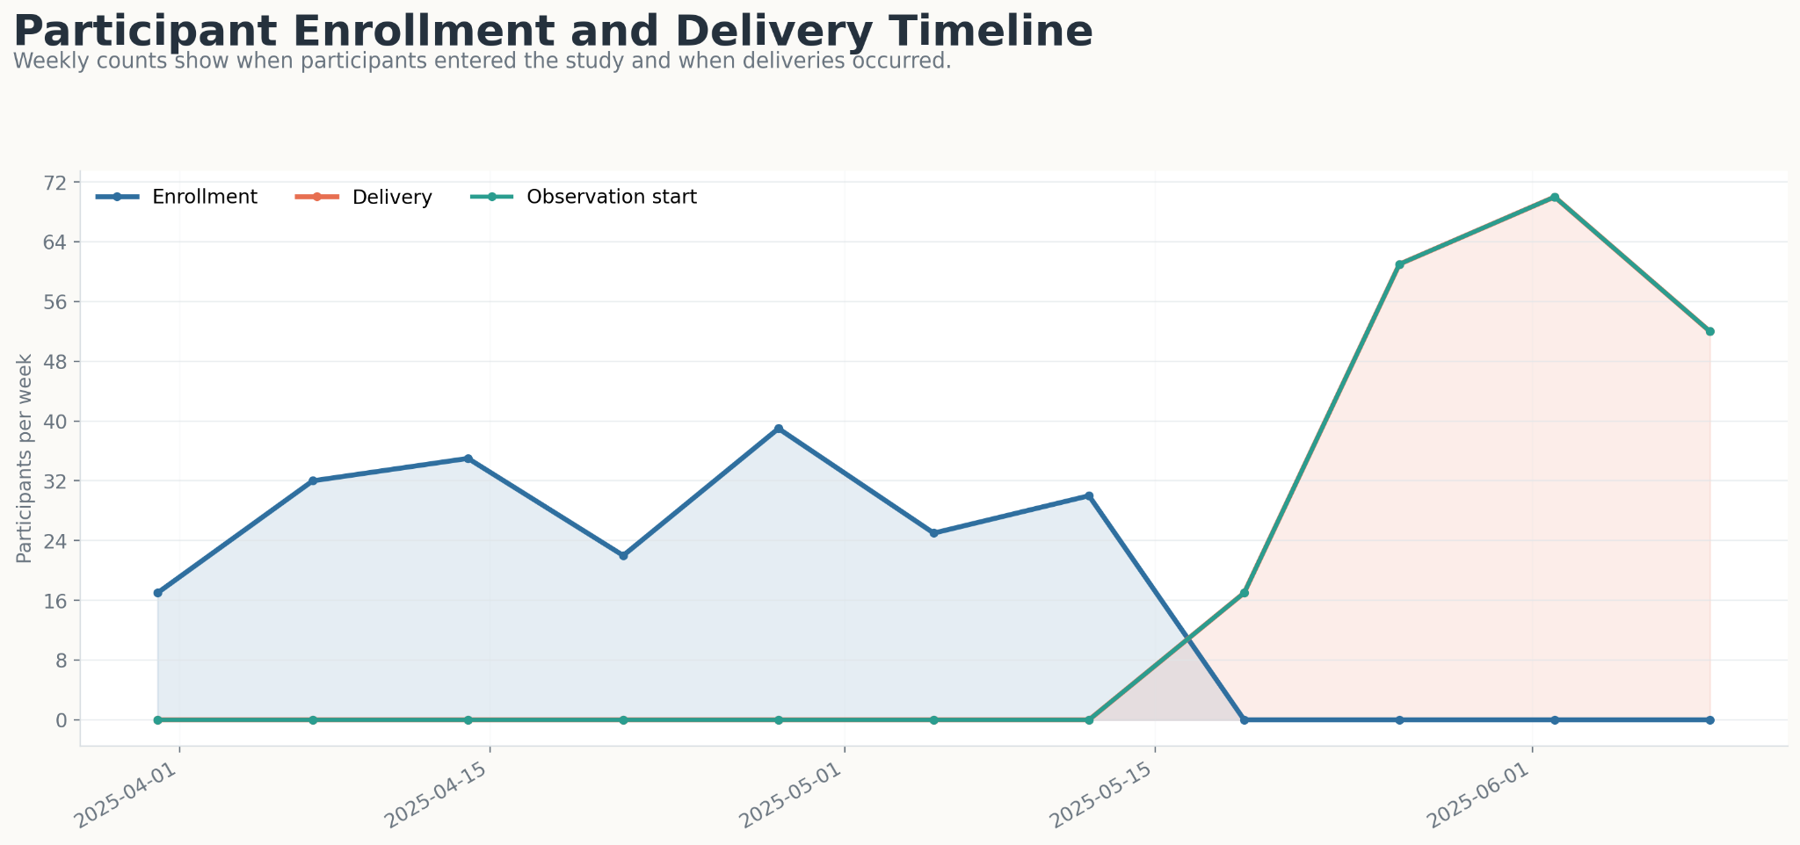

Slide 9
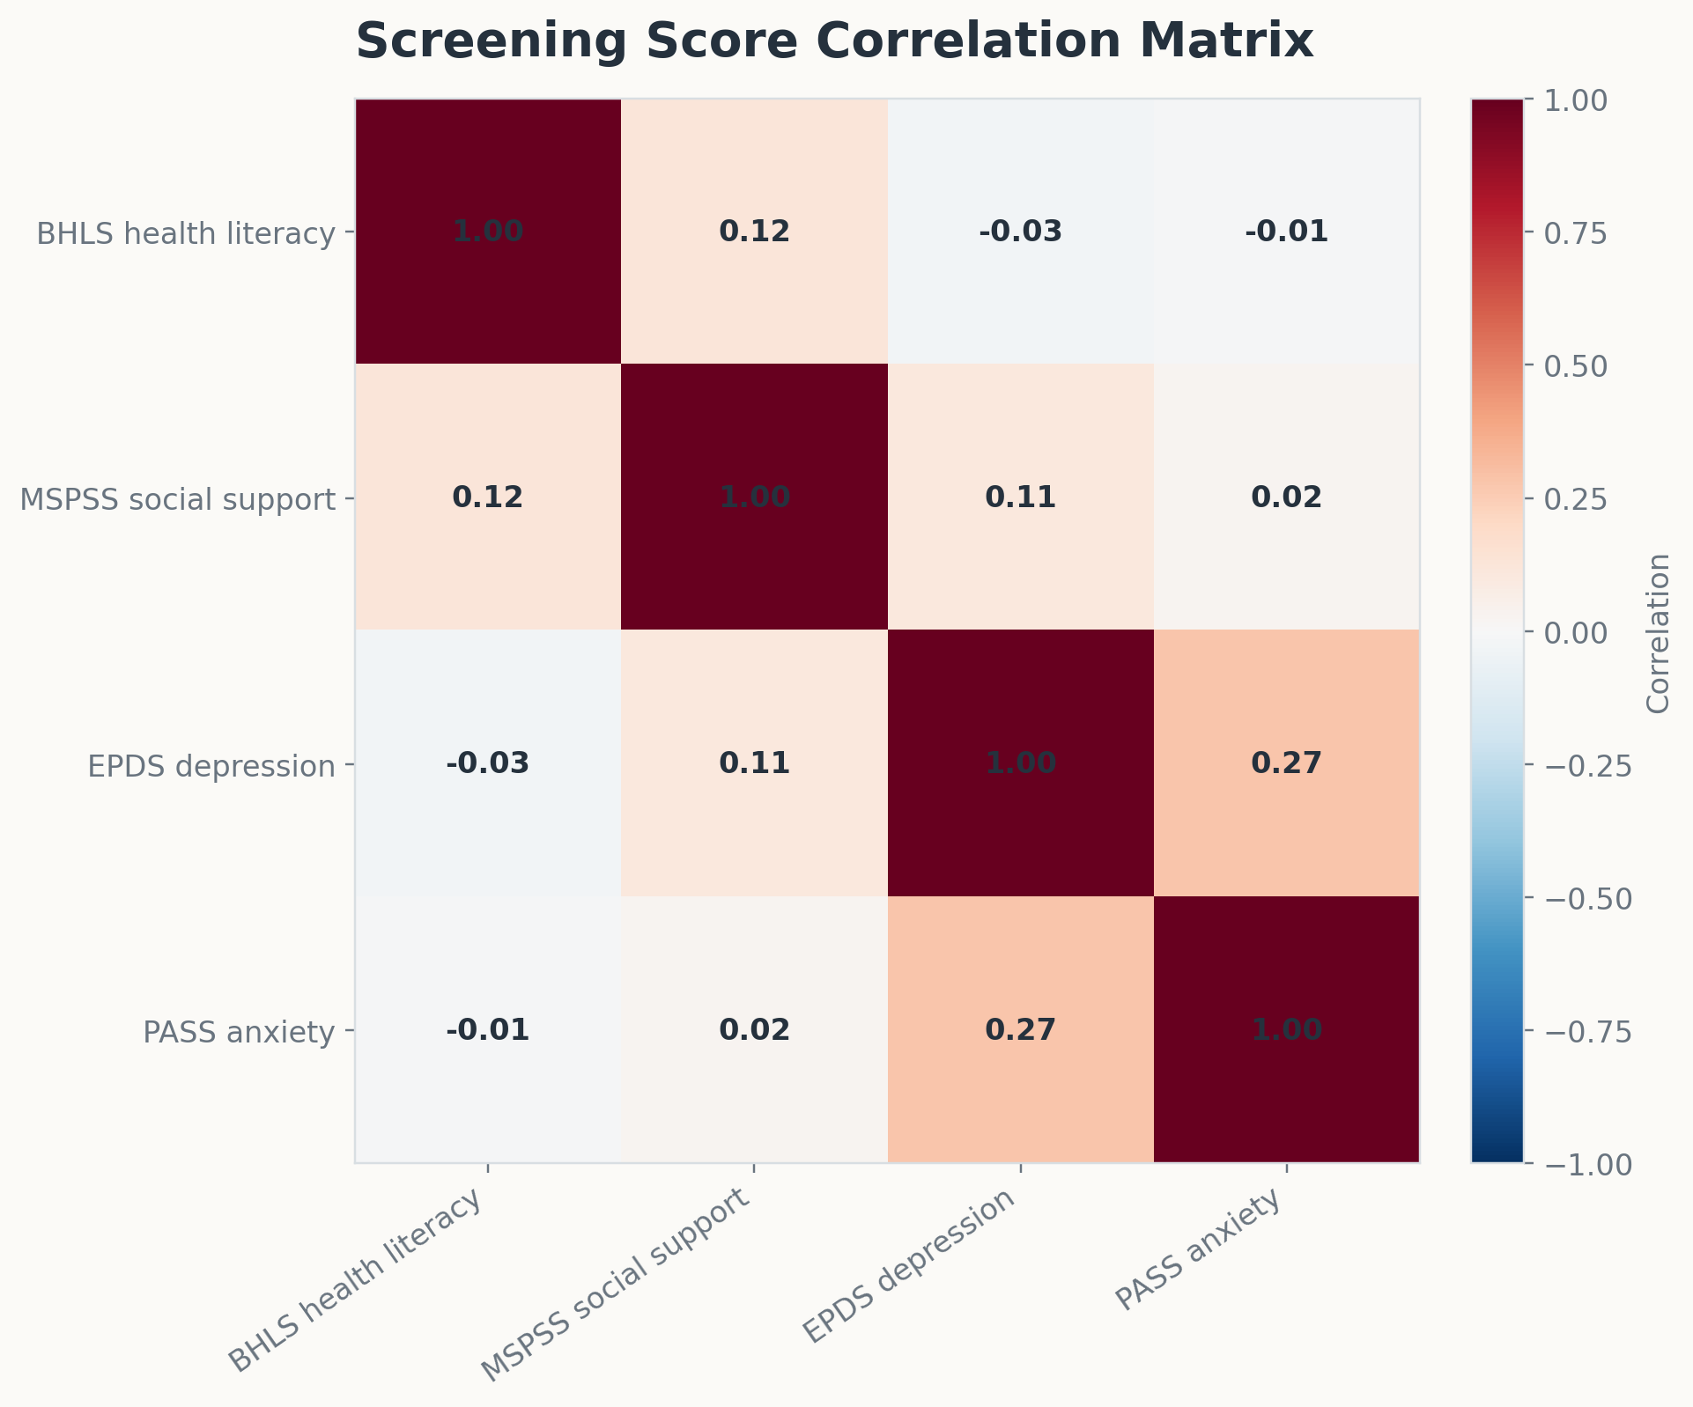

Slide 10
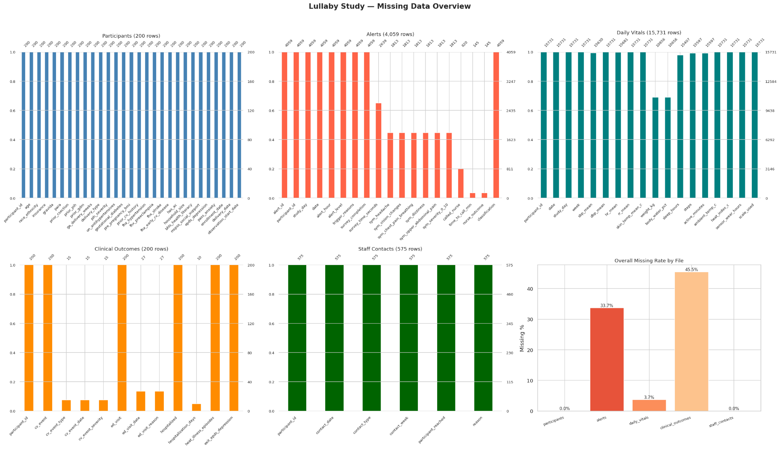

Slide 11
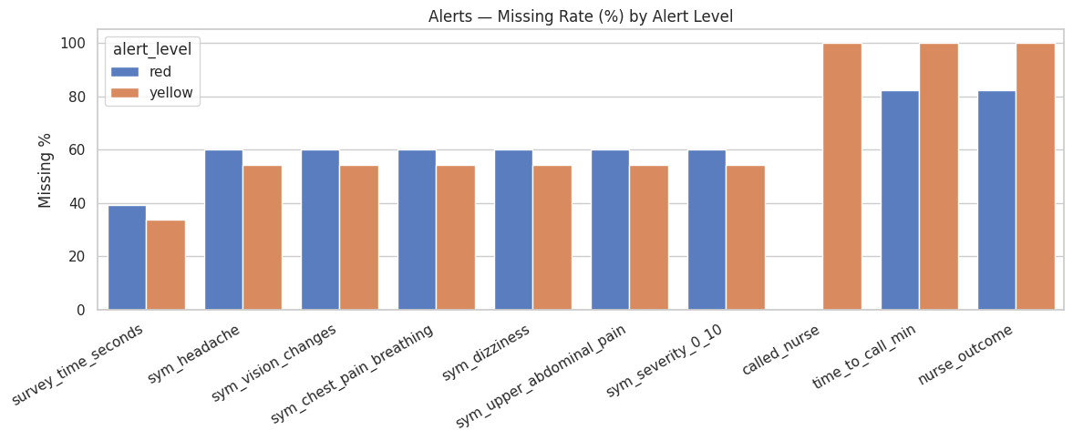

Slide 12
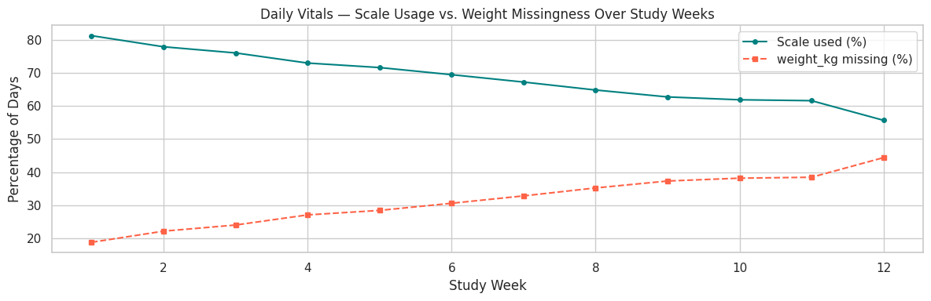

Slide 13
Challenges: How do you make sure that the data integration/curation and missing data handling techniques are solid and do not impact the performance of your downstream analytics?
Synchronize data from different sources into unified longitudinal structure
Data cleaning/quality control
Detect physiologically impossible valuables
Remove motion artifact
Identify synchronization gaps
Use wear/non-wear detection to track when devices are worn/removed to prevent treating missing data as a physiologic reading
Short vs. longer missing intervals
Rolling averages for short gaps in wearable interruptions
Different approaches for longer missing intervals
Sensitivity analyses
Complete-case analysis (remove those with too much missing data)
Multiple imputation (estimate missing values)
Forward-fill interpolation (use nearby physiologic values)

